Slide 1
Design and Implementation of a Smart Irrigation System for Precision Agriculture

Slide 2
Introduction
The Smart Irrigation System project represents a groundbreaking initiative aimed at revolutionizing precision agriculture through advanced technology integration. This project seeks to address the critical challenges of water scarcity, inefficient irrigation practices, and escalating operational costs faced by modern farming operations. By harnessing the power of IoT and data-driven decision-making, the Smart Irrigation System strives to optimize water usage, enhance crop yield, and promote sustainable agricultural practices.

Slide 3
Objectives of the Project
The primary objective of this project is to develop an advanced Smart Irrigation System :
To optimizes water usage
To enhances crop yield,
To reduces operational costs through the integration of various components, including sensors, microcontrollers, machine learning algorithms, and a web application.
To provide data-driven insights
To control mechanisms for sustainable and efficient irrigation practices in precision agriculture.

Slide 4
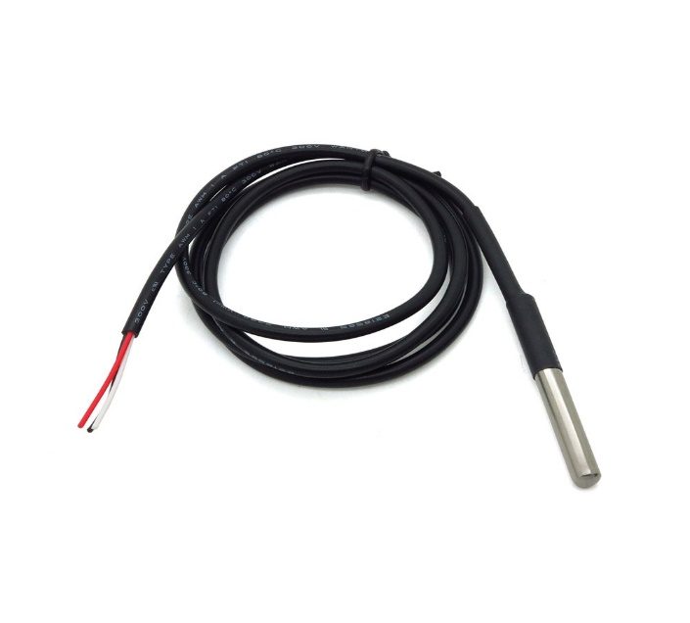
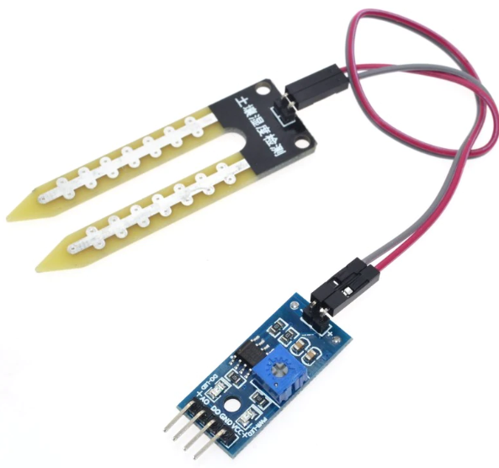
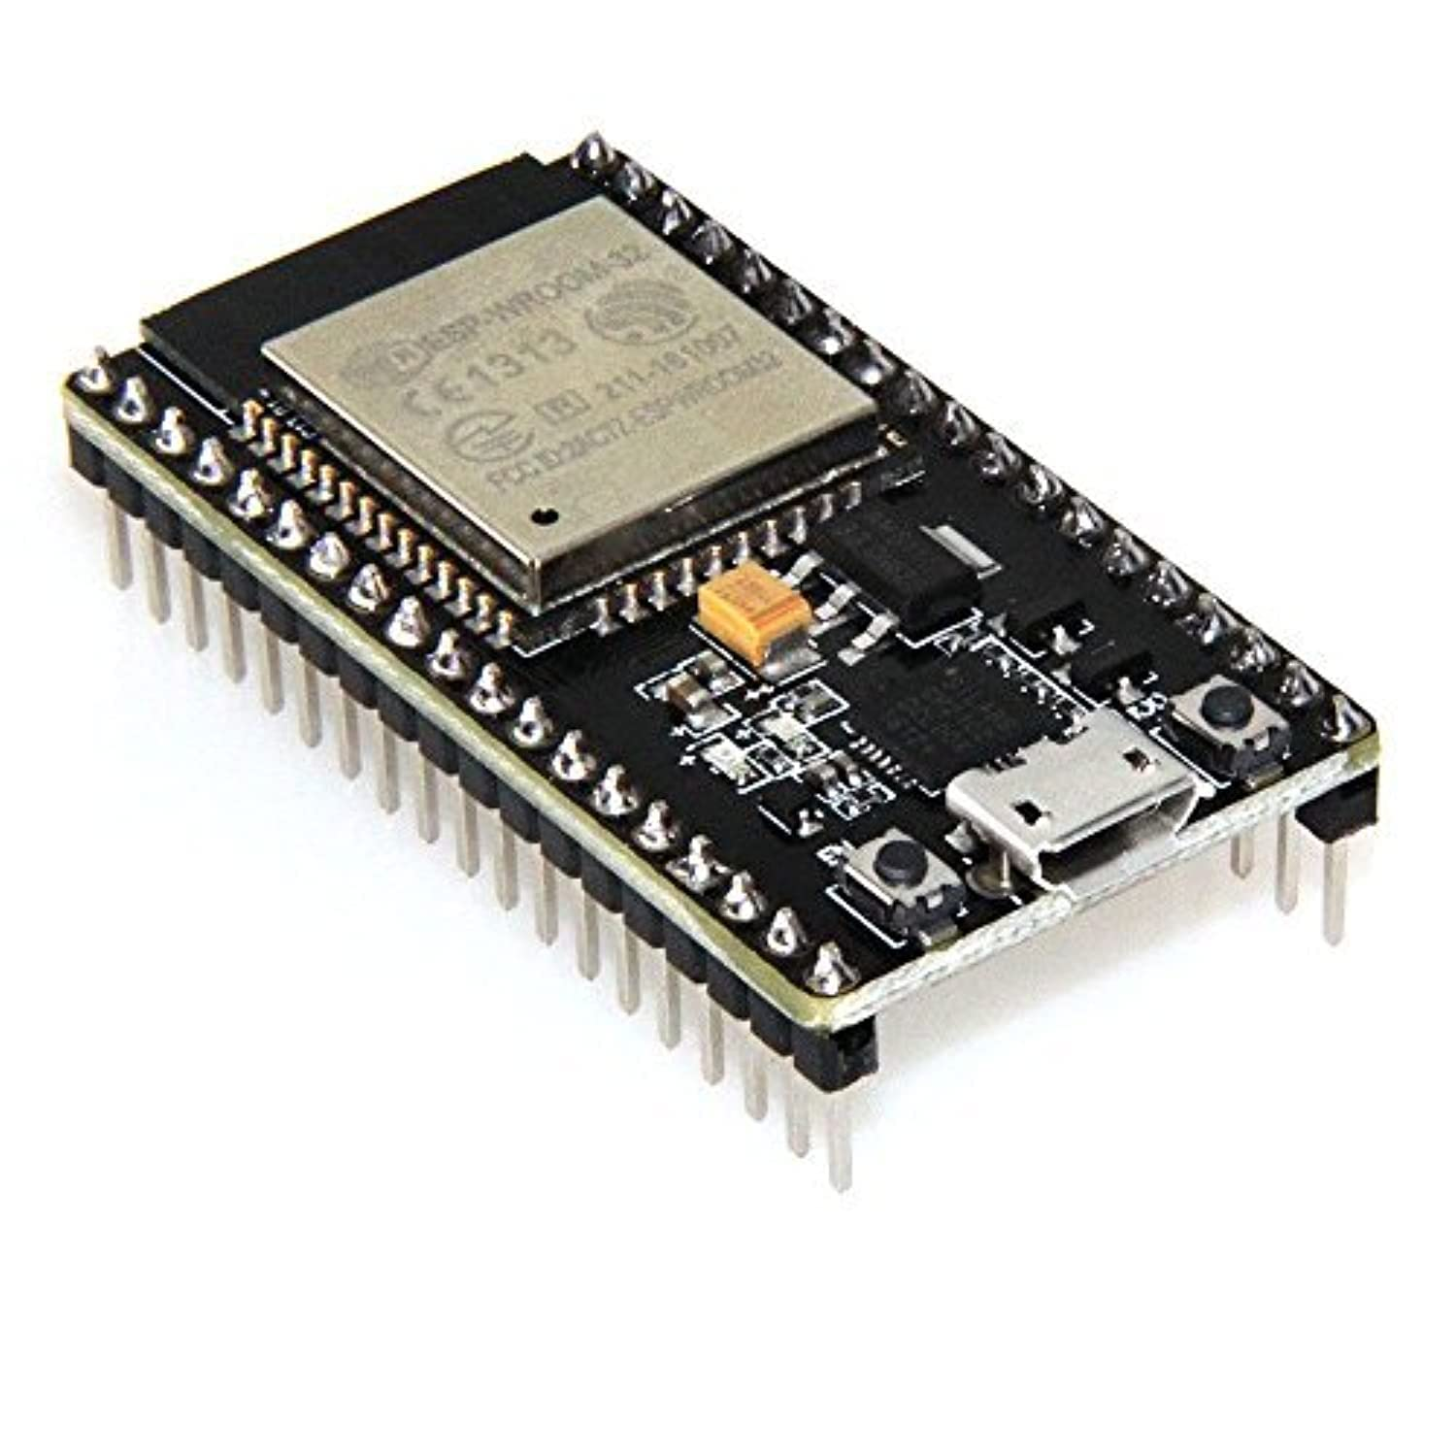
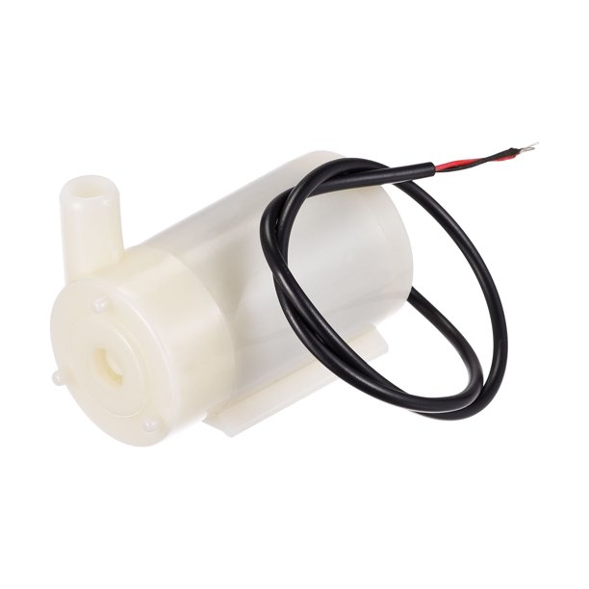
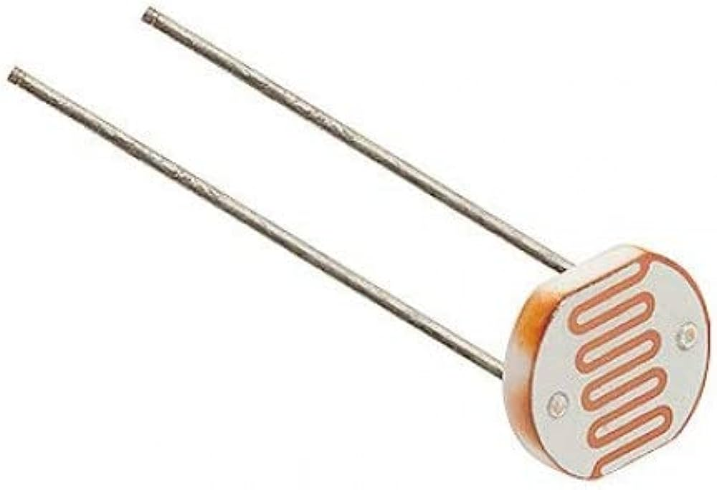
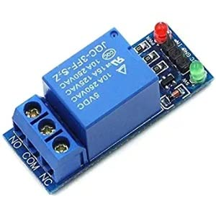
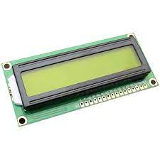
System Design
Soil moisture sensor
submersible digital temperature sensor
Water pump
Light dependent resistor
Relay
LCD
ESP32 board

Slide 5
System Design
Why these Sensors:
Soil Moisture Sensor: Placed at strategic points in the soil, this sensor measure the moisture content. This is essential for determining the water needs of the plants accurately helping us answer the question: Is the soil dry enough to warrant irrigation?
Submersible Temperature Sensor: Submerged in the soil, it provide real-time temperature readings which is crucial for determining plant health and growth patterns. By factoring in soil temperature, our smart irrigation system ensures that plants receive water at the appropriate temperature for optimal growth.
LDR (Light-Dependent Resistor): This sensor measures ambient light levels. It aids in assessing sunlight exposure, influencing irrigation schedules by accounting for varying light conditions.

Slide 6
System Operation
1. Data Analysis and Machine Learning:
Data Processing: The central controller receives data from the sensors, including soil moisture, temperature, and light conditions. The collected data is then fed into a machine learning model embedded within the microcontroller.
Machine Learning Model: The machine learning model has been trained on historical data to recognize patterns, correlations, and complex relationships between sensor inputs and optimal irrigation practices. It identifies nuanced insights that traditional threshold-based systems might miss.

Slide 7
System Operation
2. Real-Time Adjustment and Adaptive Irrigation:
Informed Frequency and Duration: The machine learning model, in conjunction with the central controller, determines whether irrigation is needed. It calculates irrigation frequency and duration, considering current sensor data and leveraging insights gained from historical data.
Adaptive Response: The system's adaptive nature comes to the forefront. The machine learning model adapts irrigation plans based on real-time conditions. If sudden temperature changes are detected, the model's understanding of plant stress and evaporation rates allows it to adjust irrigation frequency accordingly.

Slide 8
Data Analysis: Leveraging Machine Learning for Optimized Irrigation
Harnessing Data for Efficiency:
Sensors collect real-time soil moisture, temperature, and light data.
Central controller processes data and utilizes machine learning insights.
Data-Driven Insights:
Dataset informs machine learning model about plant responses.
Patterns in historical data are recognized, aiding decision-making.
Efficiency through Machine Learning:
Model predicts optimal moisture levels based on data.
Informed irrigation decisions mitigate over/under-watering.
Tailored Growth Strategies:
Machine learning enables customized irrigation plans.
Plants receive water based on individual needs and environmental factors.

Slide 9
Communication and Connectivity
Bluetooth & Web Integration: Seamlessly connect your smart irrigation system through Bluetooth and a user-friendly web application.
Microcontroller Hub: The microcontroller serves as the central hub, managing Bluetooth communication and interfacing with the web application.
Sensor-Controller Flow: Sensors collect data; microcontroller centralizes it, facilitating real-time insights and remote control.

Slide 10
Communication and Connectivity
Advantages & Usage
Effortless Interaction: Bluetooth offers quick adjustments, while the web application provides detailed analysis and remote access.
User-Centric: Dual interfaces accommodate varying preferences for real-time control and historical insights.
Practical Scenario: User receives a soil moisture alert via the web application. They access real-time data remotely using Bluetooth, optimizing irrigation based on historical trends.

Slide 11
Benefits
1. Water Conservation:
Precise Irrigation: Machine learning optimizes water distribution, targeting specific areas for minimal wastage.
Adaptive Control: Microcontroller responds to real-time data, preventing overwatering and promoting efficient usage.
2. Reduced Costs:
Lower Water Bills: Machine learning-driven irrigation reduces water consumption, translating to cost savings.
Maintenance Efficiency: Timely notifications via the web app and microcontroller insights minimize maintenance expenses.
3. Improved Plant Health:
Optimal Conditions: Machine learning-based decisions maintain the perfect moisture balance for thriving plant health.
Prevent Stress: Adaptive strategies avert under watering and plant stress, ensuring robust growth.

Slide 12
Benefits
4. User-Friendly:
Intuitive Interface: The web application offers effortless scheduling, remote control, and insightful data visualization.
Time Savings: Users manage irrigation from anywhere via the web app, saving valuable time and effort.
5. Environmental Stewardship:
Sustainable Resource Use: Machine learning-driven efficiency aligns with eco-conscious practices, conserving water and energy.
Carbon Footprint Reduction: Reduced resource consumption contributes to a greener environment and a smaller carbon footprint.
6. Practical Realization:
Example Usage: A user remotely adjusts the irrigation schedule through the web app, leveraging machine learning insights to conserve water.
Holistic Benefits: The combined power of machine learning, microcontroller, and web application delivers water savings, cost reduction, plant health enhancement, and user convenience within a single integrated system.

Slide 13
Challenges and Solutions
1.Problem: Sensor Calibration Issue
Cause: Soil moisture sensor might need calibration.
Solution: Recalibrate the sensor according to provided guidelines.
2.Problem: Water Pump Not Activating
Cause: Moisture threshold set too high.
Solution: Adjust threshold settings in the code.
3.Problem: Display Showing Incorrect Data
Cause: Code processing data incorrectly for display.
Solution: Review and correct data processing code.
4.Problem: Light Intensity Irrigation Not Functioning
Cause: Incorrect light intensity threshold configuration.
Solution: Configure light intensity threshold in code.

Slide 14
Challenges and Solutions
5.Problem: Temperature Reading Inconsistent
Cause: Wiring issues causing inconsistent temperature readings.
Solution: Check and secure wiring connections.
6.Problem: Water Pump Continuously Running
Cause: Faulty logic in the code.
Solution: Review and adjust pump control logic.
7.Problem: No Display Output
Cause: Incorrect LCD display initialization.
Solution: Ensure proper LCD display initialization in setup code.
8.Problem: Erratic System Behavior
Cause: Electrical interference from nearby devices.
Solution: Minimize interference sources, maintain a clean setup.

Slide 15
Enhancements
1. Integration of Weather Forecast:
Potential Enhancement: Incorporating real-time weather forecast data for more precise irrigation decisions.
Benefits: Prevent unnecessary irrigation if rain is expected, further optimizing water usage.
2. AI-Driven Irrigation:
Future Prospect: Integration of artificial intelligence algorithms for enhanced decision-making.
Advantages: AI adapts to complex data patterns, fine-tuning irrigation schedules for optimal plant health.
3. Soil Nutrient Monitoring:
Possible Feature: Adding sensors to monitor soil nutrient levels, enriching data-driven insights.
Benefits: Tailored irrigation strategies based on nutrient content for healthier plant growth.

Slide 16
Enhancements
4. Sensor Fusion Technology:
Emerging Trend: Utilizing sensor fusion for cross-referencing data from multiple sensors.
Advantages: More comprehensive and accurate understanding of soil conditions.
5. Adaptive Learning:
AI Expansion: AI-driven system learns from past irrigation decisions, refining strategies over time.
Implications: Constant improvement in efficiency, customization, and water conservation.
6. IoT Expansion:
Smart Integration: Extending the system's reach through more connected devices and locations.
Benefits: Centralized control over larger areas, promoting sustainable water management.

Slide 17
Conclusion

